Slide 1

Application Layer (Electronic Mail &DNS)
Lecture 4 | Part 1 of 4 | CSE421 – Computer Networks
Department of Computer Science and Engineering School of Data & Science
All material copyright 1996-2020
J.F Kurose and K.W. Ross, All Rights Reserved

Slide 2

Objectives
Principles of network applications
Web and HTTP
Electronic mail
SMTP, POP3, IMAP
DNS
P2P applications
Video streaming and content distribution networks
Socket programming with UDP and TCP

Slide 3

Electronic mail
user
agent
Three major components:
user agents
mail servers
simple mail transfer protocol: SMTP
User Agent
a.k.a. “mail reader”
composing, editing, reading mail messages
e.g., Outlook, iPhone mail client
outgoing, incoming messages stored on server
mail
server
user
agent
SMTP
mail
server
user
agent
SMTP
SMTP
user
agent
mail
server
user
agent
user
agent
outgoing
message queue
user mailbox

Slide 4
Electronic mail: mail servers
user
agent
mail servers:
mailbox contains incoming messages for user
message queue of outgoing (to be sent) mail messages
SMTP protocol between mail servers to send email messages
client: sending mail server
“server”: receiving mail server
mail
server
user
agent
SMTP
mail
server
user
agent
SMTP
SMTP
user
agent
mail
server
user
agent
user
agent
outgoing
message queue
user mailbox

Slide 5
Electronic Mail: SMTP [RFC 2821]
“client”
SMTP server
“server”
SMTP server
uses TCP to reliably transfer email message from client to server, port 25
direct transfer: sending server (acting like client) to receiving server
three phases of transfer
SMTP handshaking (greeting)
SMTP transfer of messages
SMTP closure
command/response interaction (like HTTP)
commands: ASCII text
response: status code and phrase
initiate TCP
connection
RTT
TCP connection
initiated
220
SMTP handshaking
HELO
250 Hello
SMTP transfers
time

Slide 6


Scenario: Alice sends e-mail to Bob
1) Alice uses UA to compose e-mail message “to” bob@someschool.edu
4) SMTP client sends Alice’s message over the TCP connection
2) Alice’s UA sends message to her mail server using SMTP; message placed in message queue
5) Bob’s mail server places the message in Bob’s mailbox
3) client side of SMTP at mail server opens TCP connection with Bob’s mail server
6) Bob invokes his user agent to read message
**if connection fails, it keeps retrying for few days
user
agent
mail
server
user
agent
1
mail
server
2
3
6
4
Alice’s mail server
5
Bob’s mail server

Slide 7
Sample SMTP interaction
S: 220 hamburger.edu
C: HELO crepes.fr
S: 250 Hello crepes.fr, pleased to meet you
C: MAIL FROM: <alice@crepes.fr>
S: 250 alice@crepes.fr... Sender ok
C: RCPT TO: <bob@hamburger.edu>
S: 250 bob@hamburger.edu ... Recipient ok
C: DATA
S: 354 Enter mail, end with "." on a line by itself
C: Do you like ketchup?
C: How about pickles?
C: .
S: 250 Message accepted for delivery
C: QUIT
S: 221 hamburger.edu closing connection

Slide 8
SMTP: final words
SMTP uses persistent connections
SMTP requires message (header & body) to be in 7-bit ASCII
SMTP server uses CRLF.CRLF (\r\n.\r\n) to determine end of message
Comparison with HTTP:
HTTP: pull; SMTP: push
HTTP: Server to client; vice versa
SMTP: server to server
both have ASCII command/response interaction, status codes
HTTP: each object encapsulated in its own response message
SMTP: multiple objects sent in multipart message

Slide 9
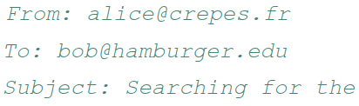
Mail message format
SMTP: protocol for exchanging email messages
RFC 822: standard for text message format:
header lines, e.g.,
different from SMTP MAIL FROM, RCPT TO: commands!
Body: the “message”
ASCII characters only
header
blank
line
body

Slide 10
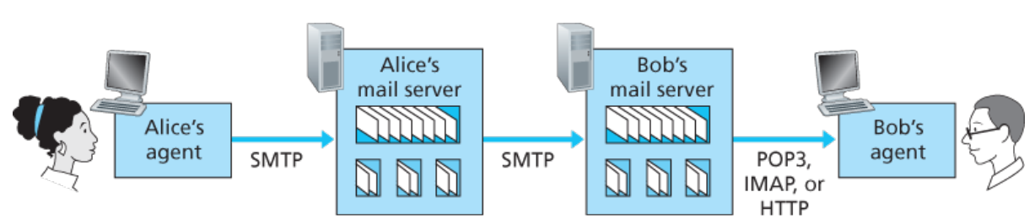
Mail access protocols
SMTP: delivery/storage to receiver’s server
mail access protocol: retrieval from server
POP: Post Office Protocol [RFC 1939]: authorization, download
IMAP: Internet Mail Access Protocol [RFC 1730]: more features, including manipulation of stored messages on server
HTTP: Web based(Gmail, Hotmail, Yahoo! Mail, etc.)

Slide 11
POP3 and IMAP
Features | POP3 | IMAP
Name | Post Office Protocol | Internet Message Access Protocol
Mail Location | Mail downloaded at the local workstation and deleted from the server. ** | Keeps all mails in one place: at the server
Accessing Mail | Mail can only be accessed using a single device at a time when using POP3. | Messages can be accessed via IMAP on a variety of devices
Update | POP3 does not allow users to create, delete, or modify mailboxes on the mail server. | IMAP allows the user to create, delete, or update mailboxes on the mail server, as well as create a folder hierarchy of mailboxes.
Readability | Once the message has been downloaded, we can only read it. | Before we finish the download, we can read the message in part.
Virus | Mail kept in workstation, vulnerable to any virus | Mails kept in server, less susceptible to virus
Port Number | 110 | 143
**POP3 “download-and-keep”: copies of messages on different clients

Slide 12
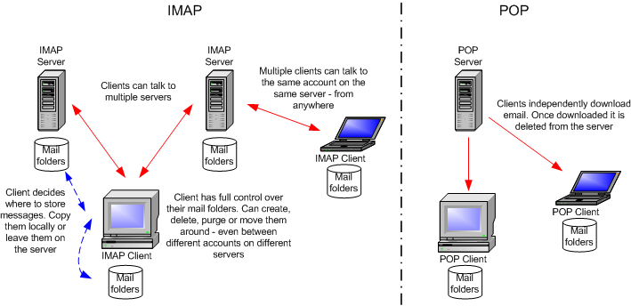
POP3 and IMAP
Source : https://www.howtogeek.com/99423/email-whats-the-difference-in-pop3-imap-and-exchange/

Slide 13
Chapter 2: Outline
Principles of network applications
Web and HTTP
Electronic mail
SMTP, POP3, IMAP
DNS
P2P applications
Video streaming and content distribution networks
Socket programming with UDP and TCP

Slide 14
DNS: domain name system
People: many identifiers:
NID, name, passport #
Internet hosts, routers:
IP address (32 bit) - used for addressing datagrams
“name”, e.g., www.yahoo.com - used by humans
Q: How to map between IP address and name, and vice versa ?
Domain Name System:
Distributed database implemented in hierarchy of many name servers
Application-layer protocol: hosts, name servers communicate to resolve names (address/name translation)
Note: core Internet function, implemented as application-layer protocol
Complexity at network’s “edge”

Slide 15
DNS: How does it work?
The user machine runs the client side of the DNS application.
The browser extracts the hostname, www.someschool.edu, from the URL and passes the hostname to the client side of the DNS application.
The DNS client sends a query containing the hostname to a DNS server.
The DNS client eventually receives a reply, which includes the IP address for the hostname.
Once the browser receives the IP address from DNS, it can initiate a TCP connection to the HTTP server process located at port 80 at that IP address

Slide 16
DNS: services, structure
DNS services
Hostname to IP address translation *DNS Cache
Host aliasing
Canonical – complicated name!
Alias names – give the canonicals a shorter name!
Can be used to get the canonical name
Mail server aliasing
Web and Mail hostname can be same
Load distribution:
Replicated Web/Mail servers: many IPs correspond to one name
Follows round robin method when distributing IP to user
Why not centralize DNS?
Single point of failure
Traffic volume
Distant centralized database
Maintenance
AND doesn‘t scale!

Slide 17

Thinking about the DNS
humongous distributed database:
~ billion records, each simple
handles many trillions of queries/day:
many more reads than writes
performance matters: almost every Internet transaction interacts with DNS - msecs count!
organizationally, physically decentralized:
millions of different organizations responsible for their records
“bulletproof”: reliability, security

Slide 18
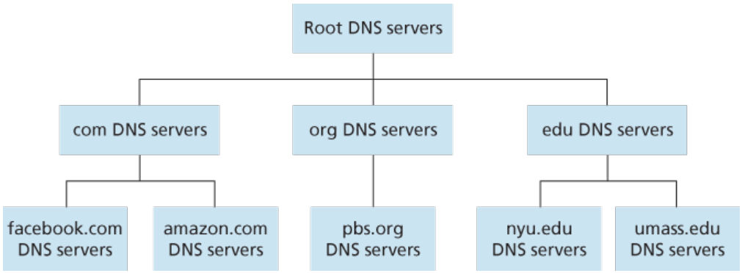
DNS: a distributed, hierarchical database
Client wants IP for www.amazon.com; 1st approximation:
Client queries root server to find the IP of .com DNS server
Client queries .com DNS server to get IP of an authoritative server of amazon.com.
Client queries amazon.com DNS server to get IP address for www.amazon.com

Slide 19
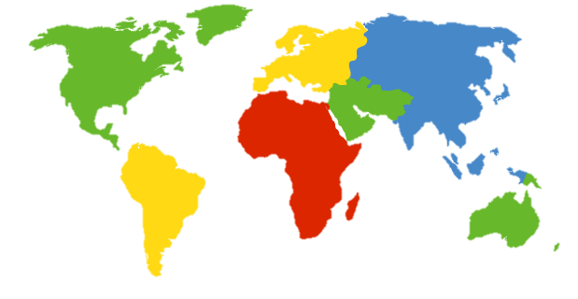
DNS: root name servers
official, contact-of-last-resort by name servers that can not resolve name
incredibly important Internet function
Internet couldn’t function without it!
DNSSEC – provides security (authentication, message integrity)
ICANN (Internet Corporation for Assigned Names and Numbers) manages root DNS domain
c. Cogent, Herndon, VA (5 other sites)
d. U Maryland College Park, MD
h. ARL Aberdeen, MD
j. Verisign, Dulles VA (69 other sites )
k. RIPE London (17 other sites)
i. Netnod, Stockholm (37 other sites)
e. NASA Mt View, CA
f. Internet Software C.
Palo Alto, CA (and 48 other sites)
m. WIDE Tokyo
(5 other sites)
13 logical root name “servers” worldwide each “server” replicated many times (~200 servers in US)
a. Verisign, Los Angeles CA
(5 other sites)
b. USC-ISI Marina del Rey, CA
l. ICANN Los Angeles, CA
(41 other sites)
g. US DoD Columbus, OH (5 other sites)

Slide 20
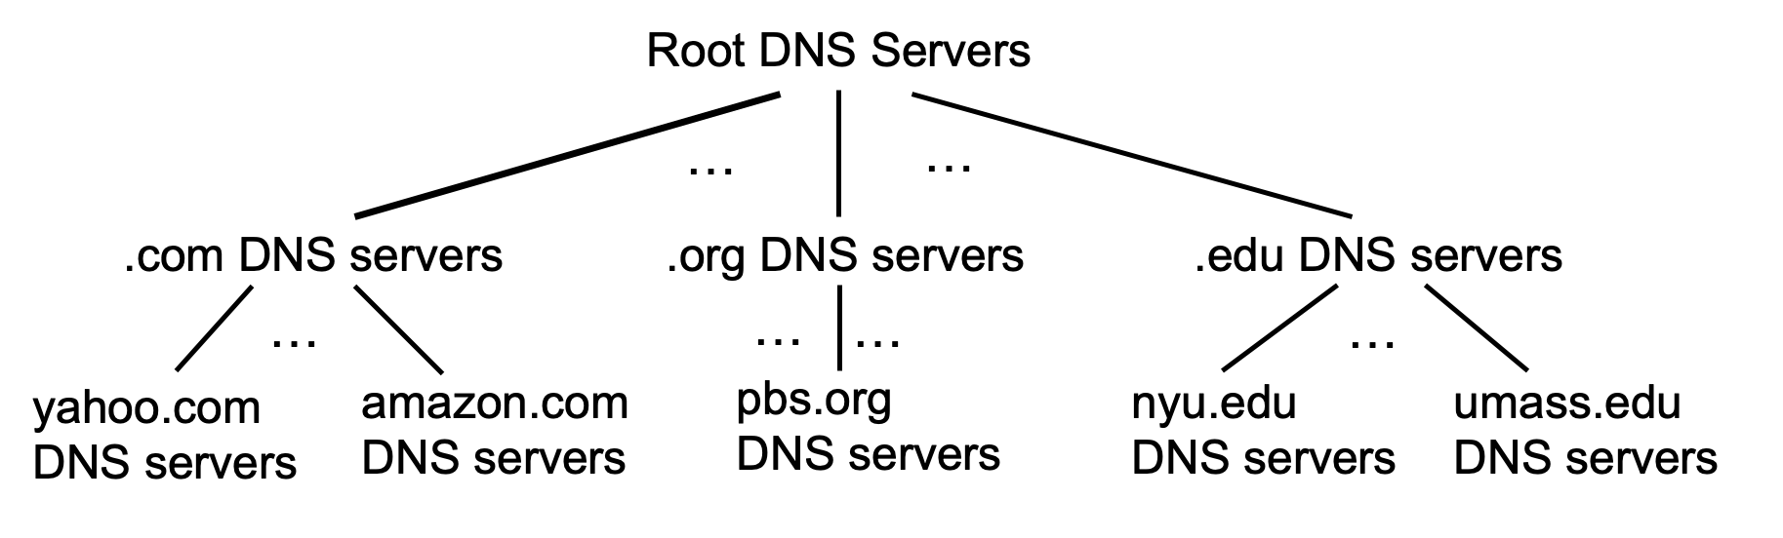
Top-Level Domain, and authoritative servers
Top-Level Domain (TLD) servers:
responsible for .com, .org, .net, .edu, .aero, .jobs, .museums, and all top-level country domains, e.g.: .cn, .uk, .fr, .ca, .jp
Network Solutions: authoritative registry for .com, .net TLD
Educause: .edu TLD
authoritative DNS servers:
organization’s own DNS server(s), providing authoritative hostname to IP mappings for organization’s named hosts
can be maintained by organization or service provider

Slide 21
Local DNS name server
Does not strictly belong to hierarchy
Each ISP (residential ISP, company, university) has one
Also called “default name server”
When host makes DNS query, query is sent to its local DNS server
Has local cache of recent name-to-address translation pairs (but may be out of date!)
Acts as proxy, forwards query into hierarchy
each ISP has local DNS name server; to find yours:
MacOS: % scutil --dns
Windows: >ipconfig /all

Slide 22
DNS name resolution: iterated query
root DNS server
Example: host at engineering.nyu.edu wants IP address for gaia.cs.umass.edu
2
3
TLD DNS server
Iterated query:
contacted server replies with name of server to contact
“I don’t know this name, but ask this server”
1
4
8
5
requesting host at
engineering.nyu.edu
local DNS server
dns.nyu.edu
gaia.cs.umass.edu
7
6
authoritative DNS server
dns.cs.umass.edu

Slide 23
DNS name resolution: recursive query
root DNS server
Example: host at engineering.nyu.edu wants IP address for gaia.cs.umass.edu
2
3
7
6
Recursive query:
puts burden of name resolution on contacted name server
heavy load at upper levels of hierarchy?
1
TLD DNS server
8
requesting host at
engineering.nyu.edu
local DNS server
dns.nyu.edu
5
4
gaia.cs.umass.edu
authoritative DNS server
dns.cs.umass.edu

Slide 24
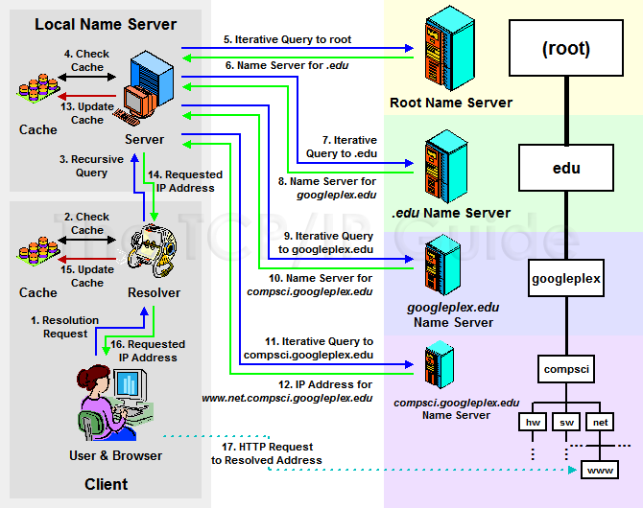
DNS Queries - Summary
Source :https://foxutech.com/what-is-dns-and-how-it-works/how-dns-works/

Slide 25
DNS: caching, updating records
Once (any) name server learns mapping, it caches mapping
Cache entries timeout (disappear) after some time (TTL)
TLD servers typically cached in local name servers
thus root name servers not often visited
Cached entries may be out-of-date (best effort name-to-address translation!)
if name host changes IP address, may not be known Internet-wide until all TTLs expire
Update/notify mechanisms proposed IETF standard
RFC 2136

Slide 26
DNS records
DNS: Distributed database storing resource records (RR)
RR format: (name, value, type, ttl)
type=A
Name is hostname
Value is IP address
(relay1.bar.foo.com, IP, A)
type=CNAME
Name is alias name for some “canonical” (the real) name
Value is canonical name
(ibm.com, server.backup.ibm.com, CNAME)
type=MX
Value is name of mail server associated with name
(fi.com, mail.fi.com,MX)
type=NS
Name is domain
Value is hostname of authoritative name server for this domain
(fi.com, dns.fi.com, NS)
**e.g. MX and NS can be use to map same domain to multiple server

Slide 27
Inserting records into DNS
Example: new startup “Network Utopia”
Register name networkuptopia.com at DNS registrar (e.g., Network Solutions)
Provide names, IP addresses of authoritative name server (primary and secondary)
Registrar inserts two RRs into .com TLD server: (networkutopia.com, dns1.networkutopia.com, NS)
(dns1.networkutopia.com, 212.212.212.1, A) (dns1.networkutopia.com, mail.networkutopia.com, MX)
Create authoritative server type A record for www.networkuptopia.com; type MX record for mail.networkutopia.com

Slide 28
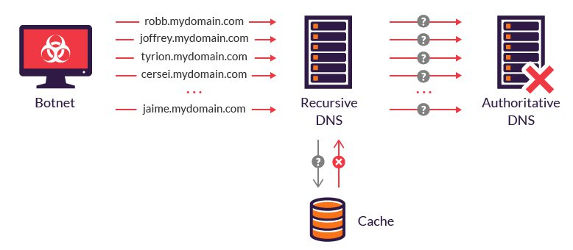
DNS security
DDoS attacks
bombard root servers with traffic
not successful to date
traffic filtering
local DNS servers cache IPs of TLD servers, allowing root server bypass
bombard TLD servers
potentially more dangerous
Source :https://www.imperva.com/learn/ddos/dns-flood/

Slide 29
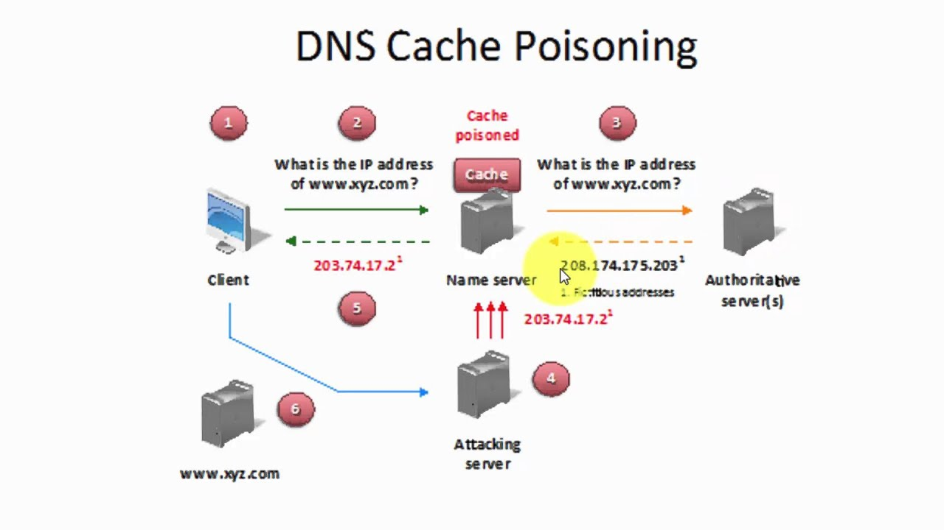
DNS security
Spoofing attacks
intercept DNS queries
And then returns bogus replies
Also known as
DNS cache poisoning
Solution
RFC 4033: DNSSEC authentication services
Uses public key cryptography (a way of digitally signing information) to verify and authenticate data.
Source : https://www.youtube.com/watch?v=71gpJ2wx7z8

Slide 30
THE END OF EMAIL AND DNS

